Slide 1
Mathematical Induction
CS/APMA 202
Rosen section 3.3
Aaron Bloomfield

Slide 2
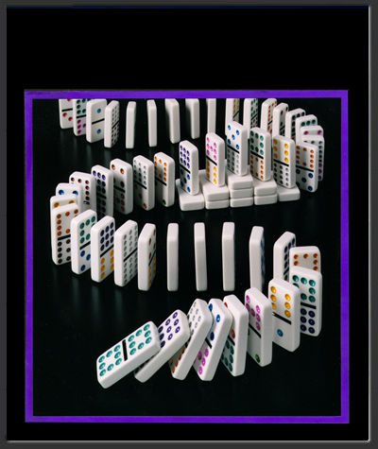
What is induction?
A method of proof
It does not generate answers: it only can prove them
Three parts:
  Base case(s): show it is true
  for one element
  Inductive hypothesis: assume
  it is true for any given element
    Must be clearly labeled!!!
  Show that if it true for the next
  highest element

Slide 3
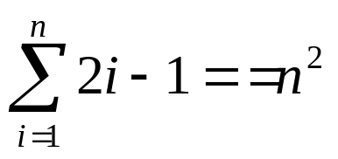

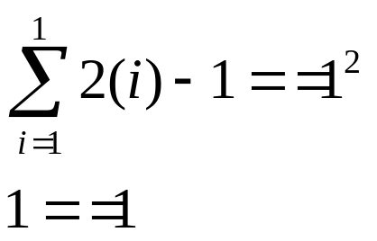


Induction example
Show that the sum of the first n odd integers is n²
  Example: If n = 5, 1+3+5+7+9 = 25 = 5²
  Formally, Show
Base case: Show that P(1) is true

Slide 4
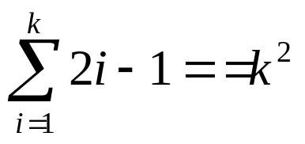
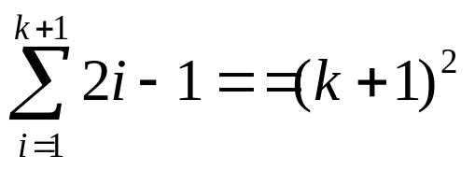
Induction example, continued
Inductive hypothesis: assume true for k
  Thus, we assume that P(k) is true, or that
  Note: we don’t yet know if this is true or not!
Inductive step: show true for k+1
  We want to show that:

Slide 5

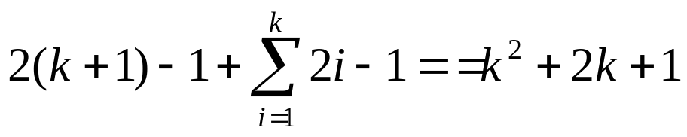


Induction example, continued
Recall the inductive hypothesis:
Proof of inductive step:

Slide 6
What did we show
Base case: P(1)
If P(k) was true, then P(k+1) is true
  i.e., P(k) → P(k+1)
We know it’s true for P(1)
Because of P(k) → P(k+1), if it’s true for P(1), then it’s true for P(2)
Because of P(k) → P(k+1), if it’s true for P(2), then it’s true for P(3)
Because of P(k) → P(k+1), if it’s true for P(3), then it’s true for P(4)
Because of P(k) → P(k+1), if it’s true for P(4), then it’s true for P(5)
And onwards to infinity
Thus, it is true for all possible values of n
In other words, we showed that:

Slide 7
The idea behind inductive proofs
Show the base case
Show the inductive hypothesis
Manipulate the inductive step so that you can substitute in part of the inductive hypothesis
Show the inductive step

Slide 8
Quick survey
I felt I understood the first example of induction…
Very well
With some review, I’ll be good
Not really
Not at all

Slide 9
Quick survey
I felt I could do my own inductive proof…
Very well
With some review, I’ll be good
Not really
Not at all

Slide 10
Why speling is not so important…
I cdnuolt blveieetaht I cluod aulaclty uesdnatnrd waht I was rdanieg. The phaonmneal pweor of thehmuan mind. Aoccdrnig to a rscheearch at Cmabrigde Uinervtisy, it deosn't mttaer in waht oredr the ltteers in a wrod are, the olny iprmoatnt tihng is taht thefrist and lsat ltteer be in the rghit pclae. The rset can be a taotl mses andyou can sitll raed it wouthit a porbelm. Tihs is bcuseae the huamn mnid deosnot raed ervey lteter by istlef, but the wrod as a wlohe. Amzanig huh? yaeh and I awlyas thought slpeling was ipmorantt.

Slide 11
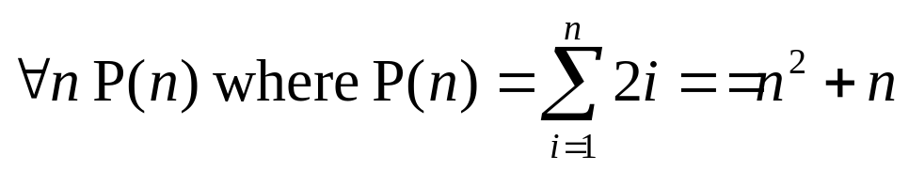
Second induction example
Rosen, section 3.3, question 2:
  Show the sum of the first n positive even integers is n² + n
  Rephrased:
The three parts:
  Base case
  Inductive hypothesis
  Inductive step

Slide 12
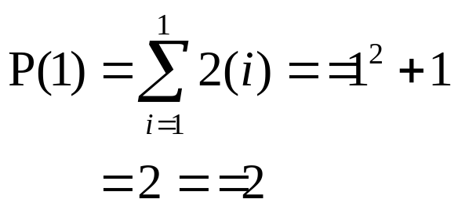
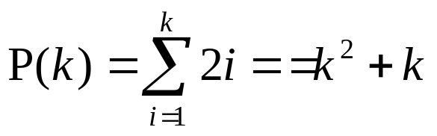
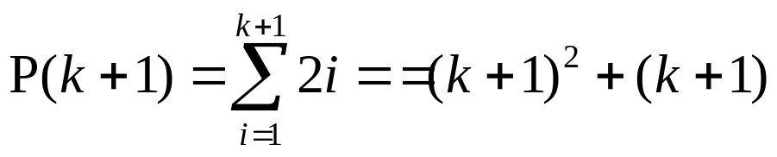
Second induction example, continued
Base case: Show P(1):
Inductive hypothesis: Assume
Inductive step: Show

Slide 13
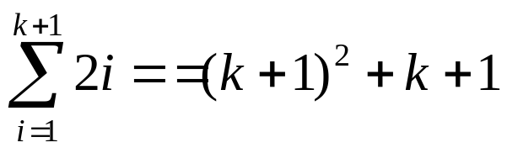
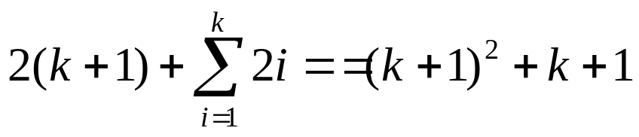


Second induction example, continued
Recall our inductive
hypothesis:

Slide 14
Notes on proofs by induction
We manipulate the k+1 case to make part of it look like the k case
We then replace that part with the other side of the k case

Slide 15
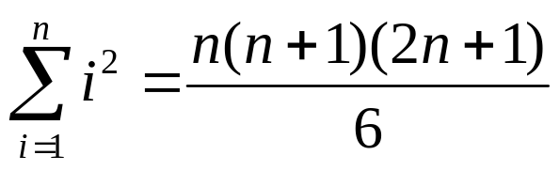
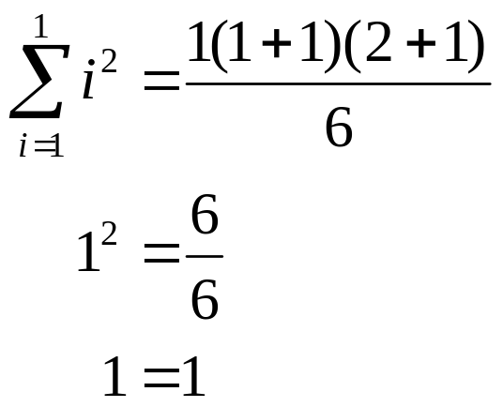
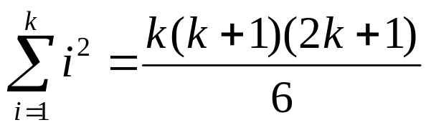
Third induction example
Rosen, question 7: Show
Base case: n = 1
Inductive hypothesis: assume

Slide 16
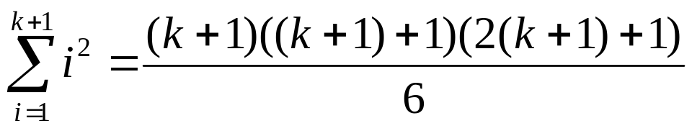

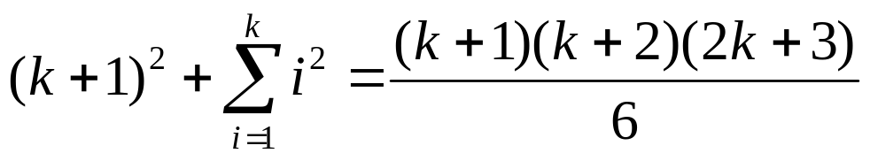
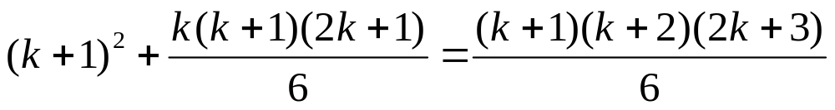
Third induction example
Inductive step: show

Slide 17

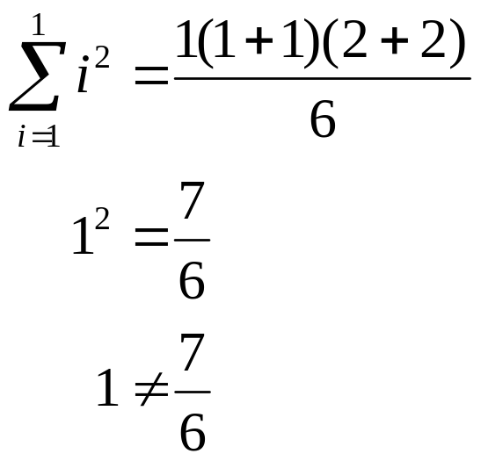
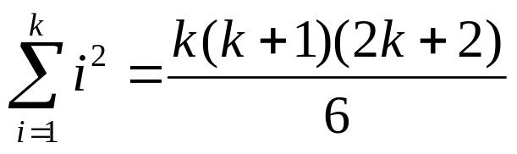
Third induction again: what if your inductive hypothesis was wrong?
Show:
Base case: n = 1:
But let’s continue anyway…
Inductive hypothesis: assume

Slide 18


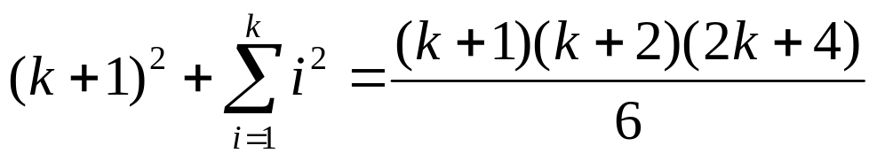

Third induction again: what if your inductive hypothesis was wrong?
Inductive step: show

Slide 19





Fourth induction example
Rosen, question 14: show that n! < n^{n} for all n > 1
Base case: n = 2
  2! < 2²
  2 < 4
Inductive hypothesis: assume k! < k^{k}
Inductive step: show that (k+1)! < (k+1)^{k+1}

Slide 20
Quick survey
I felt I understand induction…
Very well
With some review, I’ll be good
Not really
Not at all

Slide 21
Strong induction
Weak mathematical induction assumes P(k) is true, and uses that (and only that!) to show P(k+1) is true
Strong mathematical induction assumes P(1), P(2), …, P(k) are all true, and uses that to show that P(k+1) is true.

Slide 22
Strong induction example 1
Show that any number > 1 can be written as the product of primes
Base case: P(2)
  2 is the product of 2 (remember that 1 is not prime!)
Inductive hypothesis: P(1), P(2), P(3), …, P(k) are all true
Inductive step: Show that P(k+1) is true

Slide 23
Strong induction example 1
Inductive step: Show that P(k+1) is true
There are two cases:
  k+1 is prime
    It can then be written as the product of k+1
  k+1 is composite
    It can be written as the product of two composites, a and b, where 2 ≤ a ≤ b < k+1
    By the inductive hypothesis, both P(a) and P(b) are true

Slide 24
Strong induction vs. non-strong induction
Rosen, question 31: Determine which amounts of postage can be written with 5 and 6 cent stamps
  Prove using both versions of induction
  Similar to example 15 (page 250)
Answer: any postage ≥ 20

Slide 25
Answer via mathematical induction
Show base case: P(20):
  20 = 5 + 5 + 5 + 5
Inductive hypothesis: Assume P(k) is true
Inductive step: Show that P(k+1) is true
  If P(k) uses a 5 cent stamp, replace that stamp with a 6 cent stamp
  If P(k) does not use a 5 cent stamp, it must use only 6 cent stamps
    Since k > 18, there must be four 6 cent stamps
    Replace these with five 5 cent stamps to obtain k+1

Slide 26
Answer via strong induction
Show base cases: P(20), P(21), P(22), P(23), and P(24)
  20 = 5 + 5 + 5 + 5
  21 = 5 + 5 + 5 + 6
  22 = 5 + 5 + 6 + 6
  23 = 5 + 6 + 6 + 6
  24 = 6 + 6 + 6 + 6
Inductive hypothesis: Assume P(20), P(21), …, P(k) are all true
Inductive step: Show that P(k+1) is true
  We will obtain P(k+1) by adding a 5 cent stamp to P(k+1-5)
  Since we know P(k+1-5) = P(k-4) is true, our proof is complete

Slide 27
Strong induction vs. non-strong induction, take 2
Rosen, section 3.4, example 15: Show that every postage amount 12 cents or more can be formed using only 4 and 5 cent stamps
Similar to the previous example

Slide 28
Answer via mathematical induction
Show base case: P(12):
  12 = 4 + 4 + 4
Inductive hypothesis: Assume P(k) is true
Inductive step: Show that P(k+1) is true
  If P(k) uses a 4 cent stamp, replace that stamp with a 5 cent stamp to obtain P(k+1)
  If P(k) does not use a 4 cent stamp, it must use only 5 cent stamps
    Since k > 10, there must be at least three 5 cent stamps
    Replace these with four 4 cent stamps to obtain k+1
Note that only P(k) was assumed to be true

Slide 29
Answer via strong induction
Show base cases: P(12), P(13), P(14), and P(15)
  12 = 4 + 4 + 4
  13 = 4 + 4 + 5
  14 = 4 + 5 + 5
  15 = 5 + 5 + 5
Inductive hypothesis: Assume P(12), P(13), …, P(k) are all true
  For k ≥ 15
Inductive step: Show that P(k+1) is true
  We will obtain P(k+1) by adding a 4 cent stamp to P(k+1-4)
  Since we know P(k+1-4) = P(k-3) is true, our proof is complete
Note that P(12), P(13), …, P(k) were all assumed to be true

Slide 30
Quick survey
I felt I understand strong vs. weak induction…
Very well
With some review, I’ll be good
Not really
Not at all

Slide 31
An aside: IOCCC
The International Obfuscated C Code Contest
  Online at http://www.ioccc.org
C has very terse syntax
  So the contest tries to make it terser!
One common method is by modifying the whitespace

Slide 32
An aside: IOCCC
X X
X X X X
X X X X
X X X X
X X X X
X X X X
X X X X
X X X X X X
X XX X X XX X
X XXX X XXXXXXXXX X XXX X
X XXX X XXXX XXXX X XXX X
X XXXX X XX ainma(){ archa XX X XXXX X
X XXXX X oink[9],*igpa, X XXXX X
X XXXXXX atinla=etcharga(),iocccwa XXXXXX X
X XXXX ,apca='A',owla='a',umna=26 XXXX X
X XXX ; orfa(; (atinla+1)&&(!((( XXX X
X XX atinla-apca)*(apca+umna-atinla) XX X
X X >=0)+((atinla-owla)*(owla+umna- X X
X atinla)>=0))); utcharpa(atinla), X
X X atinla=etcharga()); orfa(; atinla+1; X X
X X ){ orfa( igpa=oink ,iocccwa=( X X
X X (atinla- XXX apca)*( XXX apca+umna- X X
X atinla)>=0) XXX XXX ; (((( X
X atinla-apca XXXXX XXXXXXX XXXXX )*(apca+ X
X umna-atinla XXXXXX )>=0) XXXXXX +((atinla- X
X owla)*(owla+ XXXX umna- XXXX atinla)>=0)) X
X &&"-Pig-" XX "Lat-in" XX "COb-fus" X
X "ca-tion!!"[ X (((atinla- X apca)*(apca+ X
X umna-atinla) X >=0)?atinla- X apca+owla: X
X atinla)-owla X ]-'-')||((igpa== X oink)&&!(*( X
X igpa++)='w') X )||! X (*( X igpa X ++)=owla); * X
X (igpa++)=(( X ( XXX XXX X atinla-apca X
X )*(apca+ X umna XXX - XXX X atinla)>=0) X
X ?atinla- X apca XXX + XXX owla X :atinla), X
X atinla= X X X X etcharga()) X
X ; orfa( X atinla=iocccwa?(( X (atinla- X
X owla)*(owla+ X umna-atinla)>=0 X )?atinla- X
X owla+apca: X atinla): X atinla; ((( X
X atinla-apca)* X (apca+umna- X atinla)>=0)+( X
X (atinla-owla)* X (owla+ X umna-atinla)>= X
X 0)); utcharpa( XX XX atinla),atinla X
X =etcharga()); XXXXXXX orfa(*igpa=0, X
X igpa=oink; * igpa; utcharpa( X
X *(igpa++))); orfa(; (atinla+1)&&(!((( X
X atinla-apca )*(apca+ X
X umna- XXXXX XXXXX atinla)>=0 X
X )+(( XXXXX atinla- X
XX owla)*( owla+umna- XX
XX atinla)>=0))); utcharpa XX
XX (atinla),atinla= XX
XX etcharga()); } XX
XXXX } XXXX
XXXXXXXXX
a(X){/*/X=- a(X){/*/X=-
-1;F;X=- -1;F;X=-
-1;F;}/*/ -1;F;}/*/
char*z[]={"char*z[]={","a(X){/*/X=-","-1;F;X=-","-1;F;}/*/","9999999999 :-| ",
"int q,i,j,k,X,O=0,H;S(x)int*x;{X+=X;O+=O;*x+1?*x+2||X++:O++;*x=1;}L(n){for(*",
"z[i=1]=n+97;i<4;i++)M(256),s(i),M(128),s(i),M(64),N;X*=8;O*=8;}s(R){char*r=z",
"[R];for(q&&Q;*r;)P(*r++);q&&(Q,P(44));}M(m){P(9);i-2||P(X&m?88:O&m?48:32);P(",
"9);}y(A){for(j=8;j;)~A&w[--j]||(q=0);}e(W,Z){for(i-=i*q;i<9&&q;)y(W|(1<<i++&",
"~Z));}R(){for(k=J[*J-48]-40;k;)e(w[k--],X|O);}main(u,v)char**v;{a(q=1);b(1);",
"c(1);*J=--u?O?*J:*v[1]:53;X|=u<<57-*v[u];y(X);K=40+q;q?e(O,X),q&&(K='|'),e(X",
",O),R(),O|=1<<--i:J[*J-48+(X=O=0)]--;L(q=0);for(s(i=0);q=i<12;)s(i++),i>4&&N",
";s(q=12);P(48);P('}');P(59);N;q=0;L(1);for(i=5;i<13;)s(i++),N;L(2);}",0};
b(X){/*/X=- b(X){/*/X=-
-1;F;X=- -1;F;X=-
-1;F;}/*/ -1;F;}/*/
int q,i,j,k,X,O=0,H;S(x)int*x;{X+=X;O+=O;*x+1?*x+2||X++:O++;*x=1;}L(n){for(*
z[i=1]=n+97;i<4;i++)M(256),s(i),M(128),s(i),M(64),N;X*=8;O*=8;}s(R){char*r=z
[R];for(q&&Q;*r;)P(*r++);q&&(Q,P(44));}M(m){P(9);i-2||P(X&m?88:O&m?48:32);P(
9);}y(A){for(j=8;j;)~A&w[--j]||(q=0);}e(W,Z){for(i-=i*q;i<9&&q;)y(W|(1<<i++&
~Z));}R(){for(k=J[*J-48]-40;k;)e(w[k--],X|O);}main(u,v)char**v;{a(q=1);b(1);
c(1);*J=--u?O?*J:*v[1]:53;X|=u<<57-*v[u];y(X);K=40+q;q?e(O,X),q&&(K='|'),e(X
,O),R(),O|=1<<--i:J[*J-48+(X=O=0)]--;L(q=0);for(s(i=0);q=i<12;)s(i++),i>4&&N
;s(q=12);P(48);P('}');P(59);N;q=0;L(1);for(i=5;i<13;)s(i++),N;L(2);}
c(X){/*/X=- c(X){/*/X=-
-1;F;X=- -1;F;X=-
-1;F;}/*/ -1;F;}/*/
#define X
#define XX
#define XXX
#define XXXX
#define XXXXX
#define XXXXXX
#define XXXXXXX
#define orfa for
#define XXXXXXXXX
#define archa char
#define ainma main
#define etcharga getchar
#define utcharpa putchar
#define _ -F<00||--F-OO--;
int F=00,OO=00;main(){F_OO();printf("%1.3f\n",4.*-F/OO/OO);}F_OO()
{
_-_-_-_
_-_-_-_-_-_-_-_-_
_-_-_-_-_-_-_-_-_-_-_-_
_-_-_-_-_-_-_-_-_-_-_-_-_-_
_-_-_-_-_-_-_-_-_-_-_-_-_-_-_
_-_-_-_-_-_-_-_-_-_-_-_-_-_-_
_-_-_-_-_-_-_-_-_-_-_-_-_-_-_-_
_-_-_-_-_-_-_-_-_-_-_-_-_-_-_-_
_-_-_-_-_-_-_-_-_-_-_-_-_-_-_-_
_-_-_-_-_-_-_-_-_-_-_-_-_-_-_-_
_-_-_-_-_-_-_-_-_-_-_-_-_-_-_
_-_-_-_-_-_-_-_-_-_-_-_-_-_-_
_-_-_-_-_-_-_-_-_-_-_-_-_-_
_-_-_-_-_-_-_-_-_-_-_-_
_-_-_-_-_-_-_-_
_-_-_-_
}
#include <stdio.h>
#define Q r=R[*p++-'0'];while(
#define B ;break;case
char*s="Qjou!s\\311^-g\\311^-n\\311^-c\\::^-q-ma%mO1JBHm%BQ-aP1J[O1HB%[Q<nbj\
o)*|gps)<<*txjudi)m*|aQdbtf!::::;sfuvso<aQefgbvmu;aQ<m,,a%CQ<csfbla%bQ<aN2!Q\
\ndbtf!aP2Q;m>aP2Q<a%!D12J!JGJHJOJQJFJSJJJMHS%HD12D12N3!N4\nJUJT%UQm>aP4HC%T\
Qs\\q,,^>m,2<m>aP4HC%SD12N1\nJNQm>s\\..q^aHC%NHb%GN1!D32P3%RN1UP1D12JPQUaP1H\
R%PN4\nQ<g\\(aP3Q(^>aP2Q,2<n\\(aP3Q(^>aP4Hb%OD12D12N2!N3\nJVP3Q,,<jg)aP3Q=>n\
\\(aP3Q(^*m>g\\(aP3Q(^<fmtf!m,,aHC%QN1!N1\nJ#Qqsjoug)#&e]o#-aP1Q*aHb%#Qqvut)\
aP1Q*aHb%FN1\nQm>::::aHC%VP3Q>bupj)hfut)c**aHb%JD12JON1!Qjg)a%LN1UP1D12JIQUa\
P1HL%IQ*m>aN2!N2\nP2Q<fmtf!m,,aHC%MN1!N2>P2Q>aN2\nP2Hbdd!b/d";k;char R[4][99]
;main(c,v)char**v;{char*p,*r,*q;for(q=s;*q;q++)*q>' '&&(*q)--;{FILE*i=fopen(v
[1],"r"),*o=fopen(q-3,"w");for(p=s;;p++)switch(*p++){B'M':Q(k=fgetc(i))!=EOF
&&k!=*p)*r++=k;if(k==EOF){fputs("}}\n",o);fclose(o);return system(q-6);}*r=0
B'P':while(*p!='`')fputc(*p++,o)B'O':Q*r)fputc(*r++,o);p--B'C':k=0;Q k<*p-'0'
)(*r++=fgetc(i),k++);*r=0 B'I':k= *p;if(**R==k)goto G B'G':k= *p;G:p=s;while(
*p!='$'||p[1]!= k)p++;p++B'N':R[*p-'0'][0]++;}}}

Slide 33

Chess and induction
7
6
5
4
3
2
1
0
Can the knight reach any square in a finite number of moves?
Show that the knight can reach any square (i, j) for which i+j=k where k > 1.
Base case: k = 2
Inductive hypothesis: assume the knight can reach any square (i, j) for which i+j=k where k > 1.
Inductive step: show the knight can reach any square (i, j) for which i+j=k+1 where k > 1.
0 1 2 3 4 5 6 7

Slide 34
Chess and induction
Inductive step: show the knight can reach any square (i, j) for which i+j=k+1 where k > 1.
  Note that k+1 ≥ 3, and one of i or j is ≥ 2
  If i ≥ 2, the knight could have moved from (i-2, j+1)
    Since i+j = k+1, i-2 + j+1 = k, which is assumed true
  If j ≥ 2, the knight could have moved from (i+1, j-2)
    Since i+j = k+1, i+1 + j-2 = k, which is assumed true

Slide 35
We are skipping…
The well-ordering property
Why mathematical induction is valid
These are the last two sub-sections of section 3.3

Slide 36
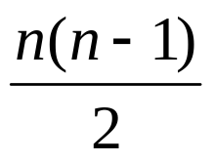
Question 40
Take a pile of n stones
  Split the pile into two smaller piles of size r and s
  Repeat until you have n piles of 1 stone each
Take the product of all the splits
  So all the r’s and s’s from each split
Sum up each of these products
Prove that this product equals

Slide 37
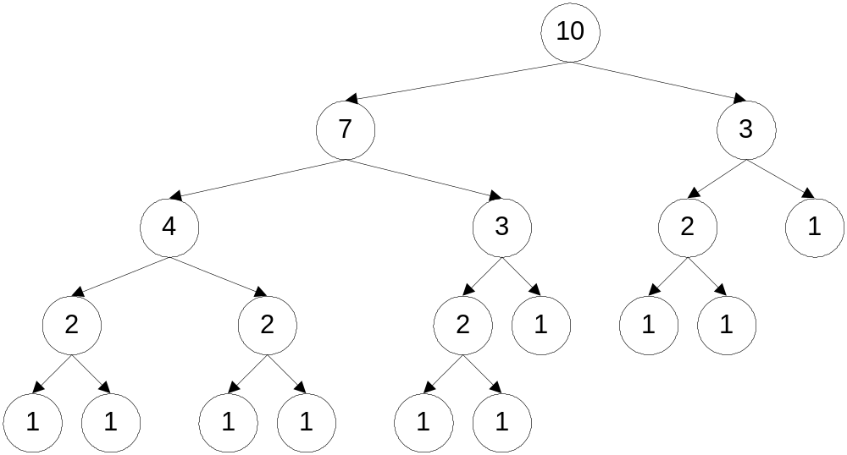
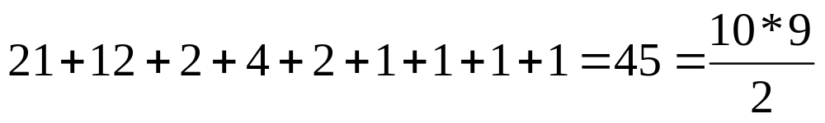
Question 40
21
12 2
4 2 1
1 1 1
10

Slide 38
Question 40
We will show it is true for a pile of k stones, and show it is true for k+1 stones
  So P(k) means that it is true for k stones
Base case: n = 1
  No splits necessary, so the sum of the products = 0
  1*(1-1)/2 = 0
  Base case proven

Slide 39
Question 40
Inductive hypothesis: assume that P(1), P(2), …, P(k) are all true
  This is strong induction!
Inductive step: Show that P(k+1) is true
  We assume that we split the k+1 pile into a pile of i stones and a pile of k+1-i stones
  Thus, we want to show that
  (i)*(k+1-i) + P(i) + P(k+1-i) = P(k+1)
  Since 0 < i < k+1, both i and k+1-i are between 1 and k, inclusive

Slide 40
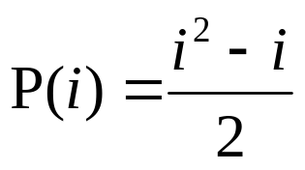
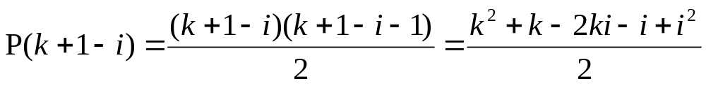
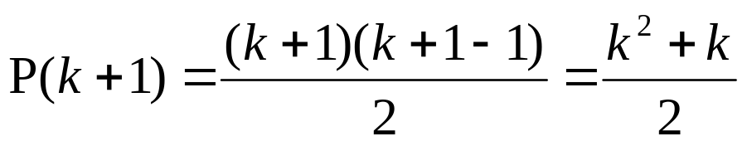
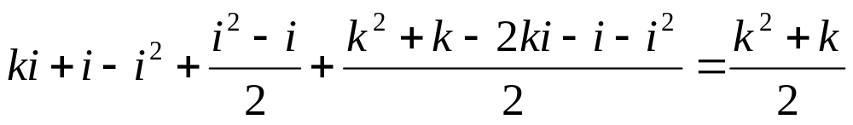

Question 40
  Thus, we want to show that
  (i)*(k+1-i) + P(i) + P(k+1-i) = P(k+1)

Slide 41
Quick survey
I felt I understood the material in this slide set…
Very well
With some review, I’ll be good
Not really
Not at all

Slide 42
Quick survey
The pace of the lecture for this slide set was…
Fast
About right
A little slow
Too slow

Slide 43
Quick survey
How interesting was the material in this slide set? Be honest!
Wow! That was SOOOOOO cool!
Somewhat interesting
Rather borting
Zzzzzzzzzzz

Slide 44
End of lecture on 21 March 2005

